Slide 1
Lesson 5
The first amendment – The fab 5
Essential Question: What rights are protected by the bill of rights and other amendments?

Slide 2
Did you Know?
Only 2% of Americans can name all five rights in the First Amendment of the Constitution.
Can you name them?

Slide 3


What do you think?
Do you think students in public schools have First Amendment rights?
Yes
No
Depends

Slide 4
Here is what the Supreme Court Had to Say:
“It can hardly be argued that either students or teachers shed their constitutional rights to freedom of speech or expression at the schoolhouse gate.”
So yes, students and teachers do have First Amendment rights at school.
However, there may be limits placed on those rights.

Slide 5
What does the first amendment say?
Congress shall make no law respecting an establishment of religion, or prohibiting the free exercise thereof; or abridging the freedom of speech, or of the press; or the right of the people peaceably to assemble, and to petition the Government for a redress of grievances.
Religion
Press
Petition
Speech
Assembly

Slide 6

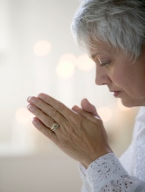


So what are the Fab 5?
Freedom of religion
Freedom of speech
Freedom of assembly
Freedom of press
Freedom of petition

Slide 7

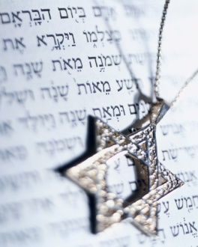
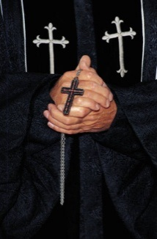

What is the freedom of religion?
“Congress shall make no law respecting an establishment of religion, or prohibiting the free exercise thereof”

Slide 8
Freedom of Religion- Meaning?
Congress cannot:
        Establish an official religion for the US
        Stop people from freely practicing or not practicing a religion
Freedom of religion is created by the establishment clause of the 1st Amendment

Slide 9
Examples
Christianity
Islam
Hinduism
Atheism
Agnostic

Slide 10
What is the freedom of speech?
Congress shall make no law… abridging the freedom of speech.
Notes:
Have student read the text of the Constitution. Ask students what they would consider speech. Is speech just the words I say? Can it be the clothing I wear? Tattoos? What I post on Facebook?

Slide 11
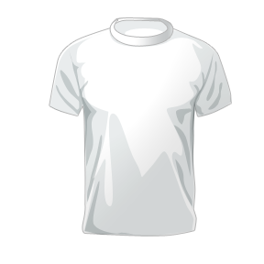



What does the constitution mean by “Speech”?
What is “speech”?
Meaning: The communication or expression of thoughts to convey a message
What kinds of speech are there? Examples?
Notes:
Discuss the definition of speech with students. Tell student speech can include things like the clothes they wear or the words on their clothes, text messages, online communication, tattoos, et cetera. Have students offer additional examples.

Slide 12
Examples
Spoken words
Clothing
Hairstyle
Music
Movies
Books
Video Games!

Slide 13
What is the freedom of Press?
Congress shall make no law… abridging the freedom …of the press

Slide 14
What does the constitution mean by “Press”?
Meaning: Press: Any format that transfers news
Why is freedom of the press important?
Imporant so we get many viewpoints, ideas, and opinions
Notes:
Discuss the definition of press. Ask student when freedom of the press is important. Tell students that some countries do not have freedom of the press and all media is controlled by the government. This results in the people only having access to the information the government shares – whether it is true or not. By having free access to the press, we are able to share ideas, express opinions, and examine multiple perspectives on issues.

Slide 15
Examples
Newspapers
TV Networks
Magazines
Social Media
Radio
Books

Slide 16
What is the freedom of Assembly?
Congress shall make no law respecting the right of the people peaceably to assemble …

Slide 17

What does the Constitution mean by “peaceably assemble”?
Peaceably: Not violent; calm
Assemble: To bring together or to gather in one place

Slide 18
examples
Protests
Meetings
Parades
Sporting Events
Birthday Parties

Slide 19
What is the freedom of Petition?
Congress shall make no law respecting…the right of the people to petition the Government for a redress of grievances …

Slide 20
What does it mean to Petition the government?
Petition: a formal request demanding a specific action from the government
What petitioning the government can look like:
Have community members sign a formal, written petition to send to government.
Peaceful Protest
Writing letters to your Representative or Senator

Slide 21
Examples
-PROTEST
-WRITING LETTERS/EMAILING GOVERNMENT OFFICIALS
-GATHERING SIGNATURES TO SUPPORT A SPECIFIC CAUSE

Slide 22
Lesson 5: Part 2
Limitations on Rights
Why are there limits on our Constitutional rights?

Slide 23

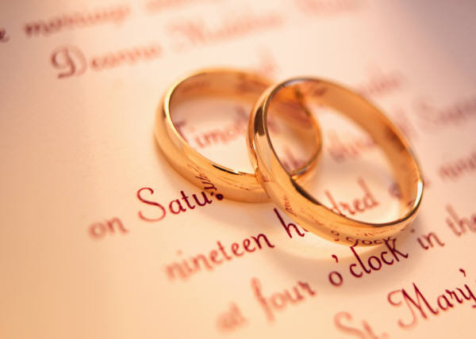
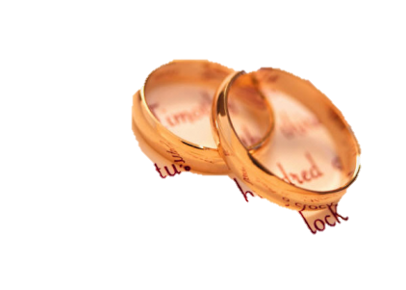
What is the Freedom of religion?
Congress cannot establish a religion for the country
and they cannot prohibit the free exercise of religion or the desire to not practice a religion at all.
What are some limits on the Freedom of Religion?
Some
examples:
Plural marriage
Illegal drug use
The government cannot limit religious beliefs, but it can limit religious practices.
Why? Prevent danger to humans and law-breaking!
First things first:

Slide 24

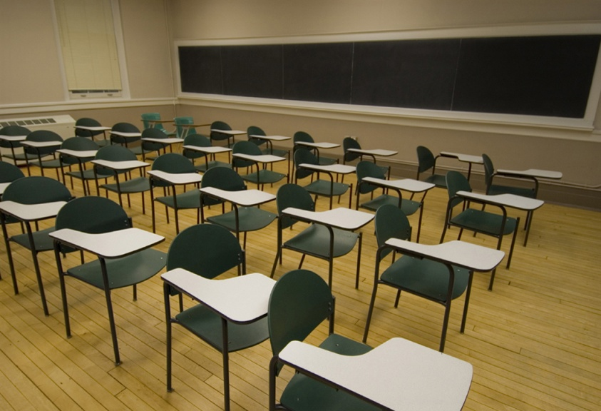
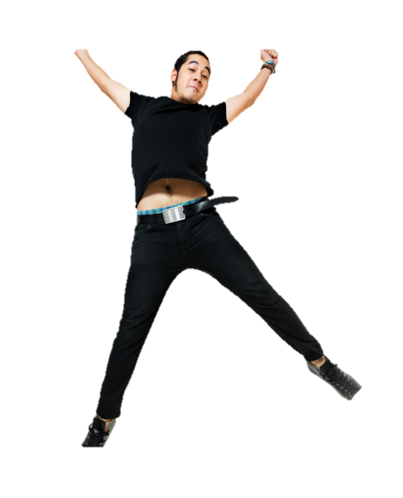
What does the constitution mean by “Speech”?
Why?: Prevent chaos, injury, law-breaking
When should speech be limited?
Because speech cannot:
Be disruptive of the learning environment
Cause a dangerous situation (be it a stampede or violence)
Other times speech can be limited:
If speech injures a person’s reputation based on false information
If speech is obscene
If speech will infringe on national security
FIRE!!
In the middle of class…
…you cannot jump out of your chair…
…and scream fire if there is no fire.
Notes:
Discuss the definition of speech with students. Tell student speech can include things like the clothes they wear or the words on their clothes, text messages, online communication, tattoos, et cetera. Have students offer additional examples.

Slide 25

What does the constitution mean by “Press”?
Press: The media and any other organizations that print, broadcast, or gather and transmit news.
Top Secret
National Security
What are some limits on the freedom of press?
Libel- Printing false information to harm another person
Slander- Saying false things about another person to harm them
-National Security
-Obscenity
Obscenity
Why: Threat to national safety, false or misleading info, explicit material
What do you think?
Libel or Slander

Slide 26
What does the Constitution mean by “peaceably assemble”?
Peaceably gather in public
Why: Prevent law-breaking, chaos
What are some limits on the freedom to assemble?
Manner
Time
Place

Slide 27
What does it mean to Petition the government?
Why? Prevent law-breaking, chaos
What petitioning the government can look like:
What would be some limits on the right to petition the government?
Have community members sign a formal, written petition to send to government.
Peaceful Protest
Writing letters to your Representative or Senator
Petition must be professional and not threatening.
Must assemble at a reasonable time.

Slide 28
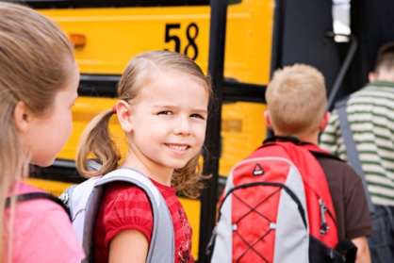
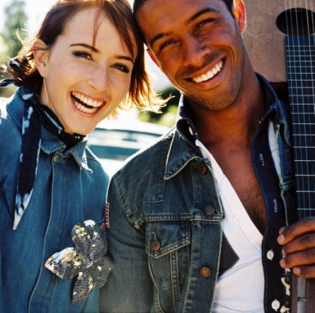

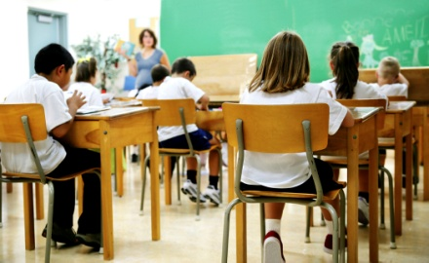
Why is it important to have limits on rights?
Rights are limited to protect the general welfare of the people.
Security
General
Well Being
Protection
Safety

Slide 29
Review: what are the Fab 5?
Freedom of religion
Freedom of speech
Freedom of assembly
Freedom of press
Freedom of petition

