Slide 1
Bell Work
On your bell work page copy and answer the following:
How do you think you did on your vocabulary test? What could you do better for next time?

Slide 2
Directions
Title Entry 7 Oath of Allegiance
It is important that you have side by side pages for this entry.

Slide 3
Bell Work
Copy the following statement and answer:
In your own words, list three promises made when US citizens take the Oath of Allegiance.

Slide 4
Bell Work
On your bell work page (or create a new one) copy the question and answer or answer the following in a complete sentence
What is the difference between and obligation and a responsibility?

Slide 5
Bell Work
Title entry 9 Obligation and Responsibility Stations
Turn to your notes and get ready to finish up

Slide 6
Obligations and Responsibilities of American Citizens
Lesson 3
Essential Question:
What are the obligations and responsibilities of citizens?

Slide 7
Is There a Difference?
What is the difference between a responsibility and a obligation?
Vocab:
Responsibility- an obligation that we meet of our own free will
Obligation- an action we are required to perform (usually by law)

Slide 8
Why do citizens have duties and responsibilities?
Benefit the common good-
beliefs or actions that are seen as a benefit to the larger
community rather than individual interests,

Slide 9
Obligations….

Slide 10
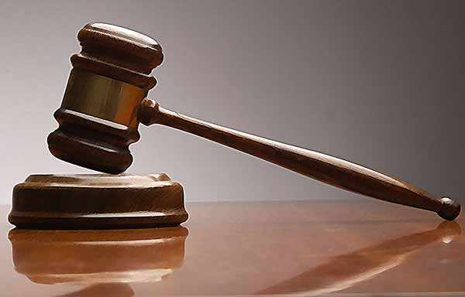
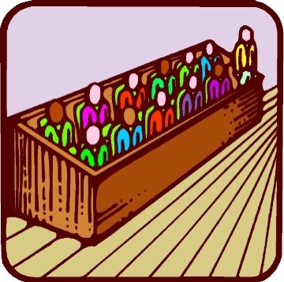
Serve in Court- Why?
Every citizen has the right to trial by jury.
Based on the 6th Amendment of the Constitution
Failing to show up for jury duty can lead to having to pay fines! $$$$

Slide 11
Obey Laws- Why?
Keep society in order and people safe!
What would society be like without laws?
Made by the Legislative Branch
Represent the citizens’ best interest
Those who break laws face jail time or deportation

Slide 12
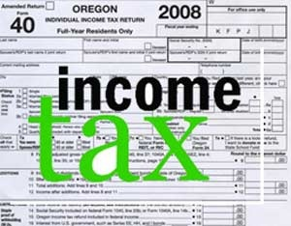
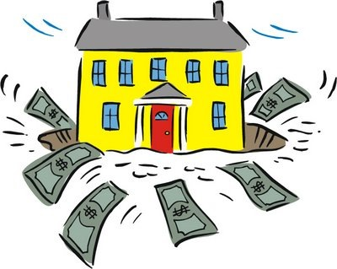
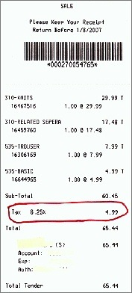
Pay Taxes- Why?
Money provides services for the citizens!
How we pay our public sector employees
(Teachers, police officers, ALL GOV. WORKERS)
No taxes = no employees, no military, no way to help the poor
Provide services for the people
Roads, hospitals, libraries, etc.
How does the government tax?
Income
Property
Goods

Slide 13
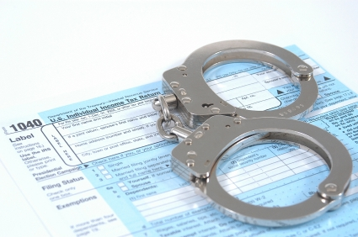
Taxes
It is ILLEGAL to not pay taxes!!
You go to prison!

Slide 14
Defend the Nation- Why?
Protection for our country in times of war!
Male citizens between the ages of 18-25 must register with the SSS (Selective Service System)
Also known as, The Draft
In emergencies, these men may be called to war
No draft since 1973
Is this fair? Should females have to register too? Why or why not?

Slide 15
https://www.sss.gov/RegVer/wfRegistration.aspx

Slide 16
Responsibilities….

Slide 17
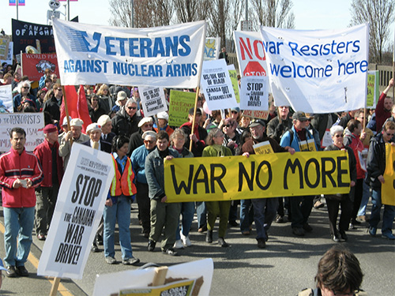
Petitioning the Government-Why?
Holding public assemblies or protests
Way to voice your opinion
Writing letters to government officials
Stating your opinions or ideas
1st Amendment Freedom
Way to express yourself

Slide 18
Voting- Why?
All citizens 18 and older
Represent YOUR interests in government!
Gives the people POWER
Our leaders are in their positions only because the people elected them!

Slide 19
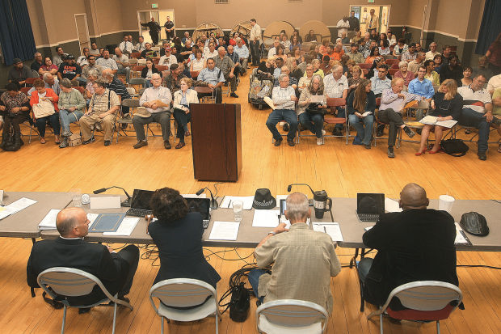
Attend Civic Meetings- Why?
Actively participate in government
Interests groups, candidates running for office, religious groups and the media all hold these meetings
Government gets ideas directly from the people!

Slide 20
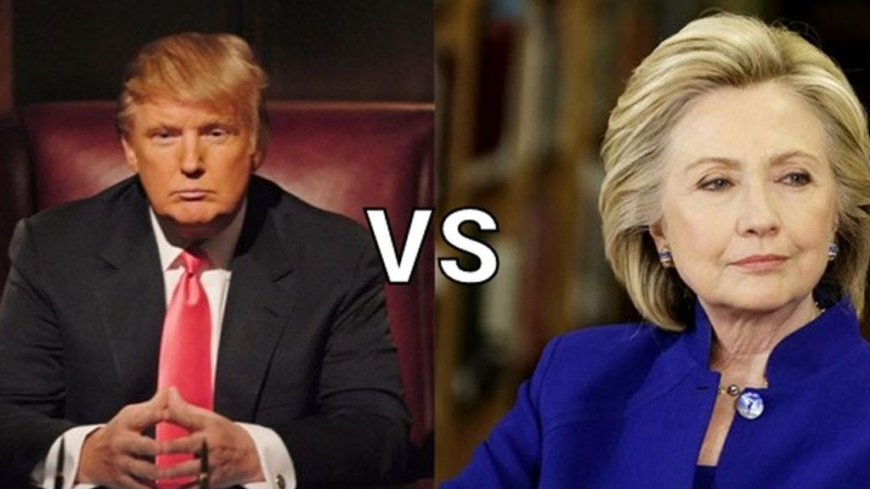
Run for Office- Why?
Represent your ideas as well as the ideas of others

Slide 21
Community Service- Why?
Helps those in need! ☺
Volunteering in your neighborhood or city!
What are some ways you can volunteer?

