Slide 1
Bell Work 12/09
Write down today’s agenda in your planner
Then double check your notebook with these page numbers and glue in the assignments
Pg 48 ASOU Questions
Pg 49 Bell Work
Pg 50 Revolution Battles
Pg 51 AOC Matrix
Pg 52 Crash Course AOC
Pg 53 Shays’s Rebelion

Slide 2
Directions
Turn to page 54
Title it Shays’ Rebellion and set up Cornell Notes
Only Copy what is in RED

Slide 3
Shays’ Rebellion

Slide 4
The Great Depression
After the war, each state began issuing its own paper money
Example: Trying to use Euros in America
The more money in circulation= money is worth less.
Soda=$1.00 (today) Soda=$2.00 (January)
Finances collapsed
Paper money was refused as worthless
Gold and silver were hoarded by people
1784-1789: worst depression the colonies had seen

Slide 5
Debtors in Trouble
In Massachusetts refused to print worthless money. So the state decided to collect taxes on land instead.
This hurt farmers the most due to owning large amounts of land.
Farmers tried to use their crops to pay their debts, but it wasn’t enough
If they failed to pay their bills they were thrown into jail until the bills were paid or forced to sell their land
Farmers all over the colonies rioted
In Massachusetts Daniel Shays led the rebellion

Slide 6
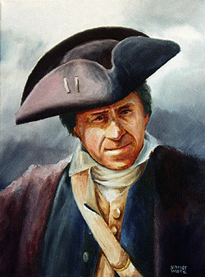
Who Was Daniel Shays
Former Continental army captain
Demanded more paper money, tax relief, relief for debtors and an end to imprisonment for debt

Slide 7
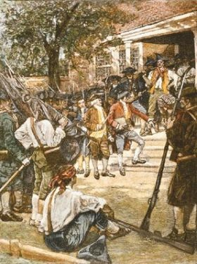
Shays Rebellion 1786-1787
January 1787: Shays and his mob of farmers went to Springfield armory to get more guns and ammunition
The government did not help them so they gathered together and marched on the courts that were taking the farmers land and sending them to debtors prison.

Slide 8
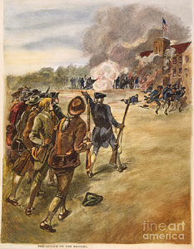
Shays’ Rebellion Cont.
They figured if the courts weren’t open they couldn’t keep taking away land or throwing any more farmers in jail.
Finally, about 900 state militia men were sent to stop the uprising.
4 of Shays men were killed and 24 were wounded.
14 others, including Shays were sentenced to death for treason.
But newly elected Governor John Hancock pardoned the men.

Slide 9
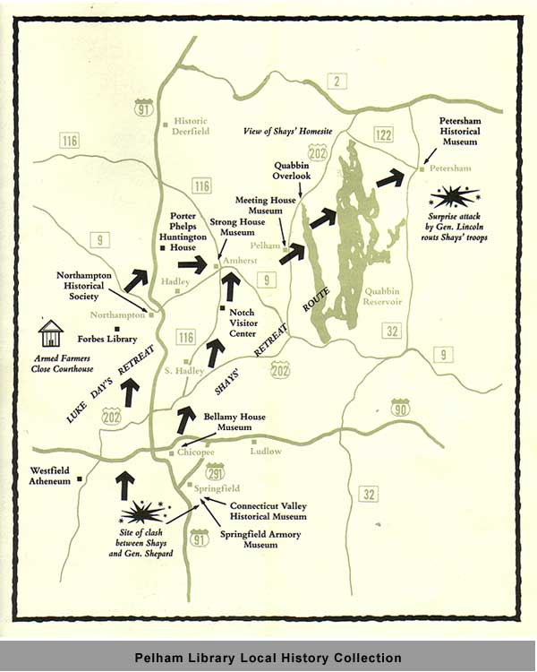

Slide 10
The Effect of Shays’s Rebellion
The Federalist’s used Shay’s rebellion as an example of civil unrest.
They argued that a strong national government was needed to settle this kind of dispute.
Shays rebellion proved the federal government was too weak and a stronger national government was needed.

Slide 11
There could be no stronger evidence of the want of energy in our governments than these disorders.
- George Washington

Slide 12
In what way did Shays’ Rebellion of 1786 lead to the formation of the United States Constitution?
It demonstrated a need for a process for accepting territories into the union.
Disputes between states could not be resolved without a national judiciary.
It showed that farmers needed the right to vote in national elections.
The lack of a national army showed the need for a stronger national government.

