Slide 1
Bell Work
On your bell work page copy the following questions
Pretend that you are an explorer in the new world.
What kind of land forms and water would you settle by?
Why would you pick these areas?

Slide 2
Bell Work
Write down today’s agenda
Turn to your Bell Work page and complete the following:
List 3 reasons why water is important for settlements. Give a one sentence explanation for each reason.

Slide 3
Directions
Title entry 12 Bill Nye Climate
Title entry 13 Land and Water
Copy the underlined notes

Slide 4
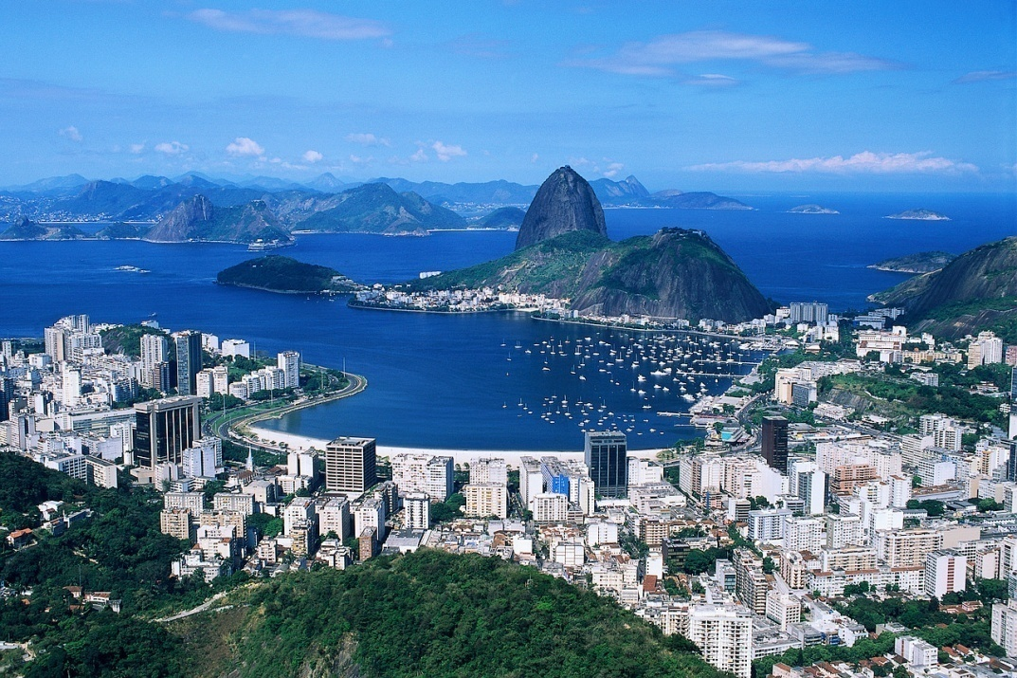
Water and Land
What it means to settlements in America

Slide 5
Pacific Ocean

Slide 6
Notes
The Pacific Ocean is the largest of the five.
This large water way allows for travel from Asia to the United States.
Besides transportation, why else would people want to settle near water?
Notes:
The Pacific Ocean covers 1/3 of the earth’s surface.

Slide 7
Atlantic Ocean

Slide 8
Notes
The Atlantic is a widely used ocean for transportation throughout history
The coast line varies from the rocky coasts of New England to the sunny beaches of Florida.
Which Part of the coast line do you think would be easier to settle on?

Slide 9
Chesapeake Bay

Slide 10
Notes
The Chesapeake Bay is fed by multiple rivers including the Potomac.
The Bay’s calm water provide ships with natural protection from the Atlantic Ocean.
The Bay not only provides transportation to the colonist but creates a market place for various trade ships and explorers.
Notes:
Captain John Smith first explored the Chesapeake Bay in 1608.

Slide 11
Mississippi River

Slide 12
Notes
The Mississippi is a major shipping route for barges carrying large items.
The Mississippi River has played a crucial role in economic growth and settlement within the United States
It is also source of fresh fish and shrimp.
Notes:
It was a major source of transportation until the 1800s when the railroad system was built.

Slide 13
Why Do People Settle Near Water Ways?
Transportation
Food Source
Fresh Water
Bathing water

Slide 14
The Great Plains

Slide 15
Notes
This soil is rich in nutrients and this creates land that is great for farming.
This is why many people settled there, and continue to live and farm there today.

Slide 16
Cape Cod

Slide 17
Notes
Cape Cod woodlands and meadows that encourage the growth of settlements.
The woodlands and meadows of the bay provide shelter and food sources for settlers of that region

Slide 18
Mt. McKinley

Slide 19
Notes
This is a NON-EXAMPLE of a place to settle.
The terrain on Mt. McKinley is very hazardous and rough. This makes it difficult for people to settle and create a home there.
Why would people NOT want to settle here?

Slide 20
Appalachian Mountains

Slide 21
Notes
The most of the Appalachian Mountains stay below the timberline and escape the cold harsh climate of the other mountains within the range.
The climate and the soil make the region suitable for farming.
This range has very few passes through them and it creates a natural barrier to protect the American colonies.
Notes:
Environmental Regions that are appropriate for a settlement.
Savannas allow for grazing and farming
Deserts can provide mineral wealth
Grasslands are the most important food-producing regions

Slide 22
Lesson Wrap-up
Think Pair Share
30 sec of think time, and then share with your face partner
How does this information help you in understanding the basic needs of creating a settlement?
How is this information helpful to you in a history class?

Slide 23
Bell Work
Take out your mental maps from the last lesson and review why water and land is important for settlement.

Slide 24
Create a Continent
Lets go over directions for your project!
You are going to create and develop your own continent

