Slide 1
Bell Work
Title entry 3 Growth Mindset

Slide 2
Growth Mindset

Slide 3
Think-Pair-Share
Are people born smart? Or do they have the ability through hard work become smart?

Slide 4
What is Mindset?
It’s the belief about our abilities and how it affects our learning!

Slide 5
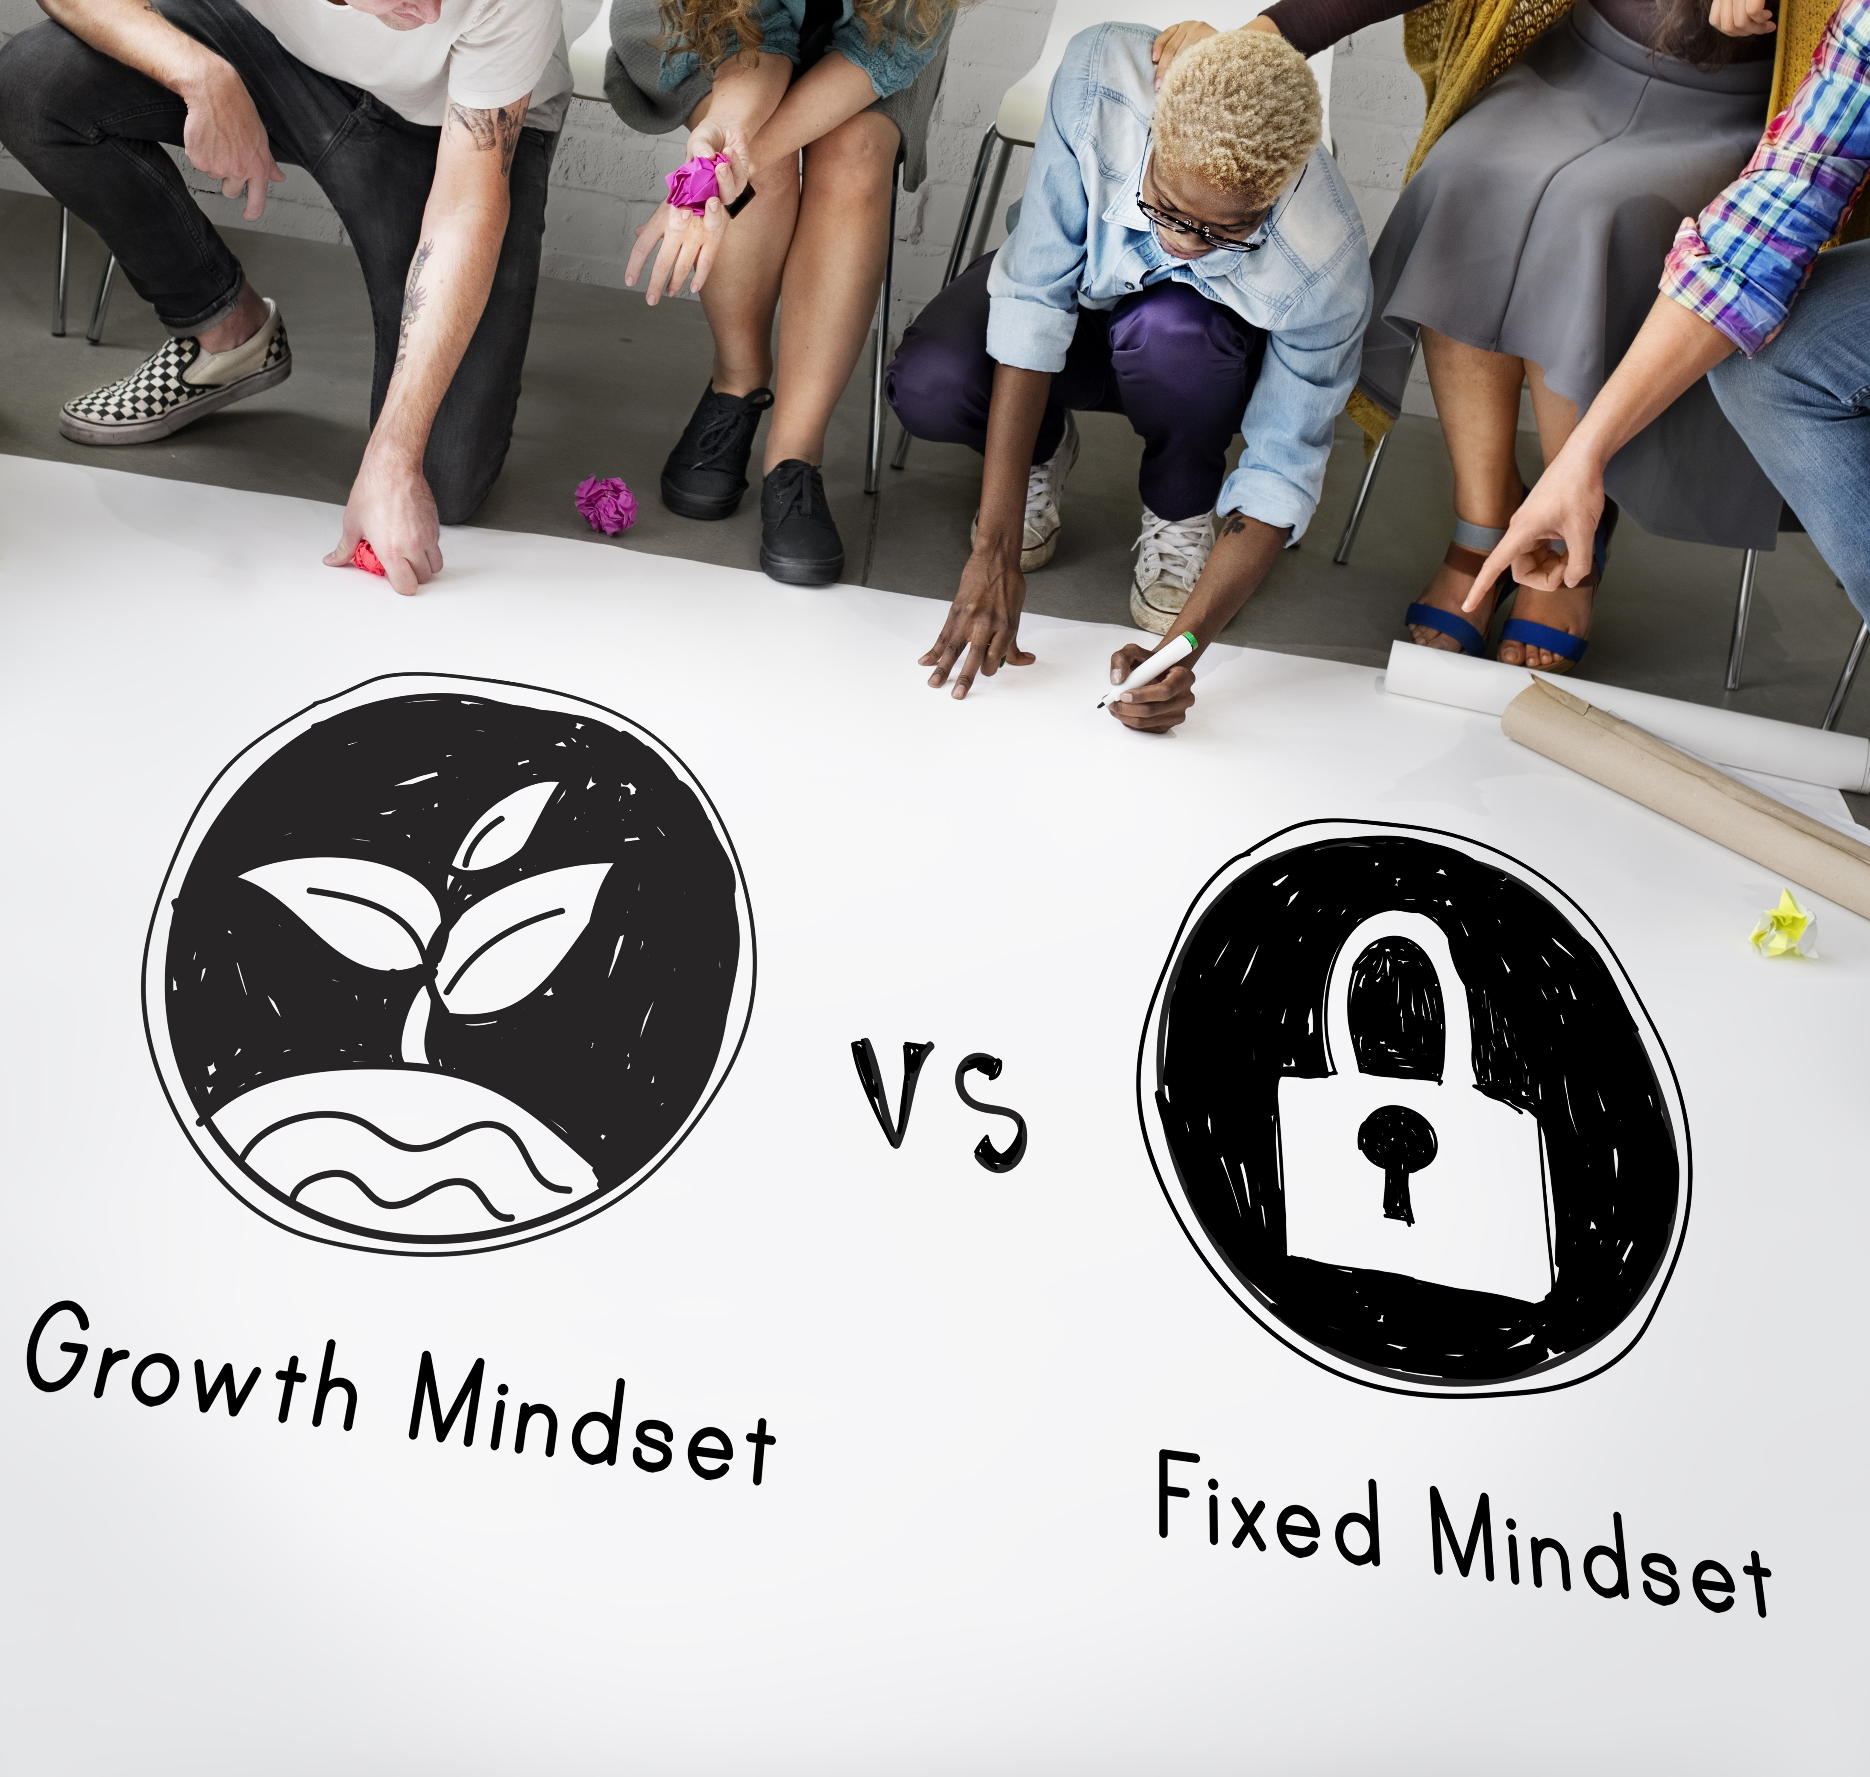
Two Types of Mindsets
Fixed Mindset: intelligence is a fixed ability. You are either smart or you are not
Growth Mindset: intelligence can be taught and your brain can be trained to grow.

Slide 6
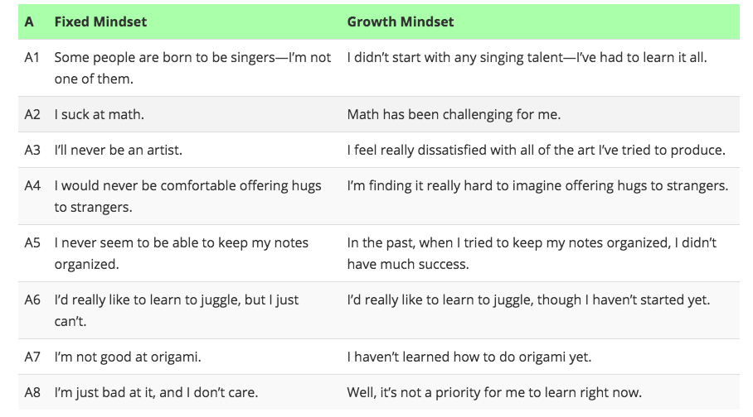
Fixed vs Growth Mindset

Slide 7
Do or do not
Starwars Mindset

Slide 8
After the Video Discussion
What was Yoda asking Luke to do?
Tell words that Luke said to Yoda.
Tell words Yoda said to Luke
Who had a Growth Mindset?
Who had a Fixed Mindset?
Who was successful?

Slide 9
Rally Robin
Starting with student in seat 3 and moving around the table, all students will provide an answer to the following question:
What was one time that you had a fixed mindset when it came to a problem?

Slide 10
Notes:
NOTE: To change images on this slide, select a picture and delete it. Then click the Insert Picture icon
in the placeholder to insert your own image.

Slide 11
Mindset Mondays
Subtitle

Slide 12
What do we do?
Talk about the months motto
Complete a journal entry about mindset
Have a mindset quote

